Slide 1
Mental Wellness Web Application
COMP3441 Advanced Web Application Development
Timothy Young
21000469
18/11/2024

Slide 2
Introduction
Showcase: Mental Wellness Website Prototype
Address design principles using accessibility, usability and scalability
Tools used for development
Alignment with target audience needs
Accessibility principles: Perceivable, Operable, Understandable, Robust (POUR)
Notes:
Information: W3 Schools (12/2024) W3 Schools Accessibility Tutorial. Available at: https://www.w3schools.com/accessibility/index.php (Accessed: 13/12/2024).

Slide 3
Target Audience
Primary users
Students and professionals seeking mental health resources
User needs
Accessible and scalable platform
Support for various accessibility modes(Light/Dark mode, text size)

Slide 4
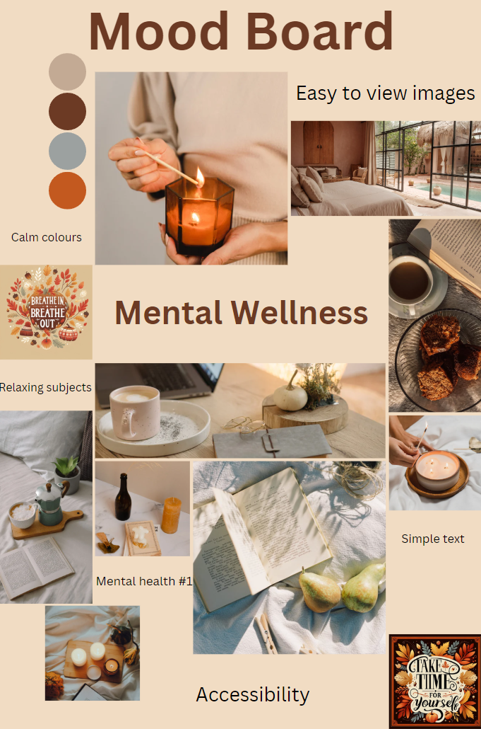
Design principles
Mood Board
Calming theme
Easy to view
Simple
Consistent colour scheme
High contrast mode for readability
Notes:
Canva(12/2024) Canva - Projects. Available at: https://www.canva.com/design/DAGS48I7CvU/g9uzKAsApRgUgyfTl2GWSw/edit?utm_content=DAGS48I7CvU&utm_campaign=designshare&utm_medium=link2&utm_source=sharebutton (Accessed: 09/12/24).

Slide 5
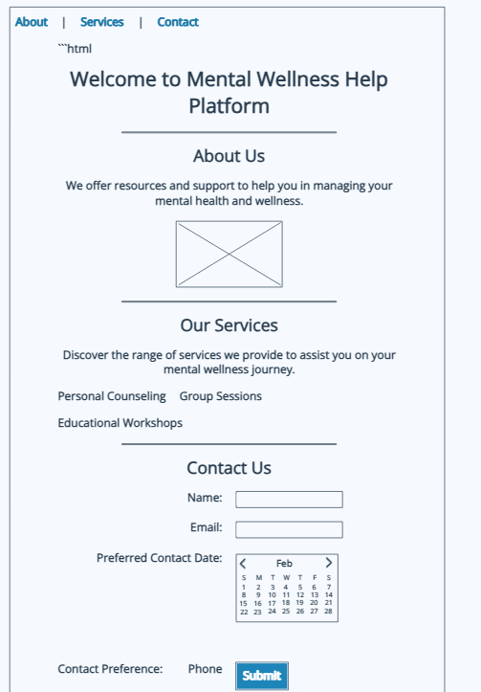
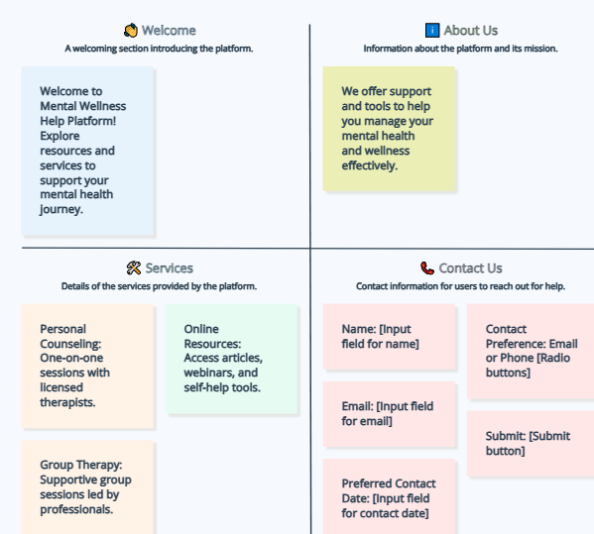
Wireframes
Design principles
Simple layout
Brief overview of what to offer
Low fidelity
Easy to iterate and modify
Not realistic in terms of user experience or visual appeal
Shows main pages
High fidelity
Closer to final product
Shows better layout
More time consuming and expensive to make
Notes:
Wireframes: MockFlow (12/2024) MockFlow – Wireframes. Available at: https://mockflow.com/ (Accessed: 13/12/24).

Slide 6

Accessibility
POUR – Perceivable, Operable, Understandable, Robust
Light/Dark mode toggle
Text size options
Clear navigation structure
Contrasting information
Screen reader enabled
All of these were tested and compliance with WCAG 2.2 guidelines

Slide 7
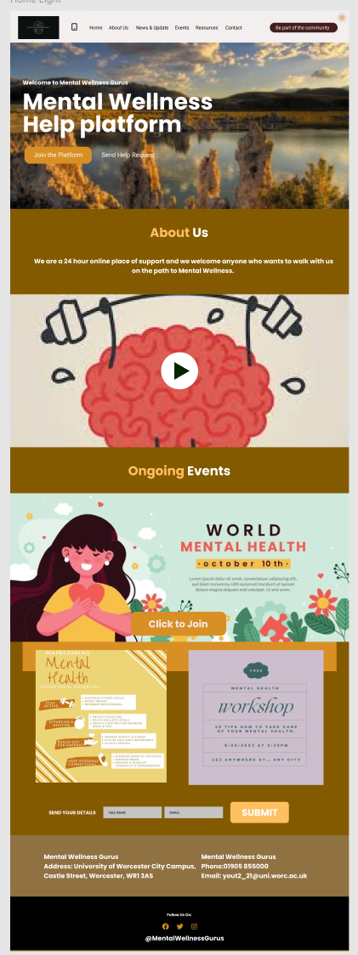
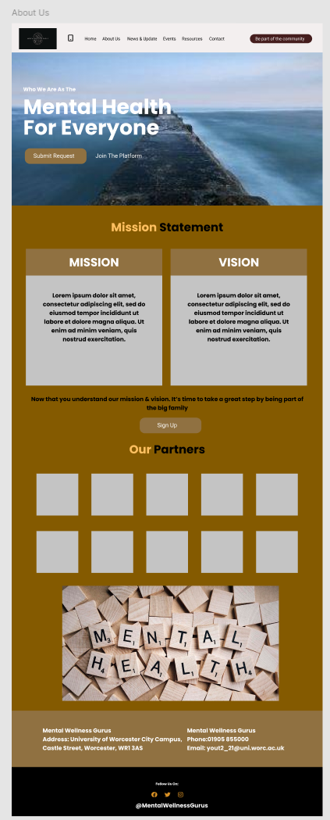
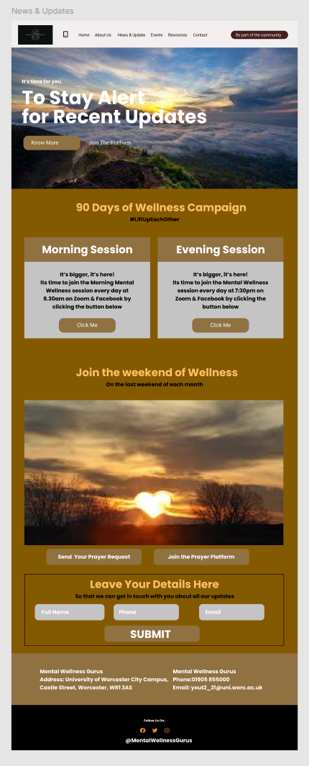
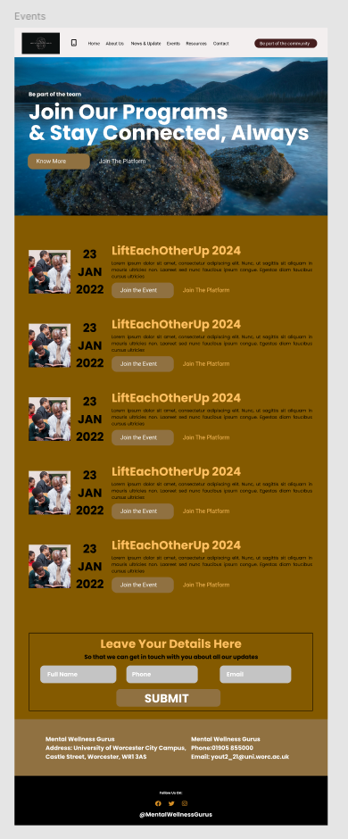
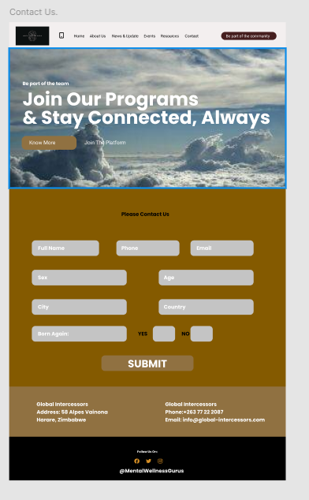
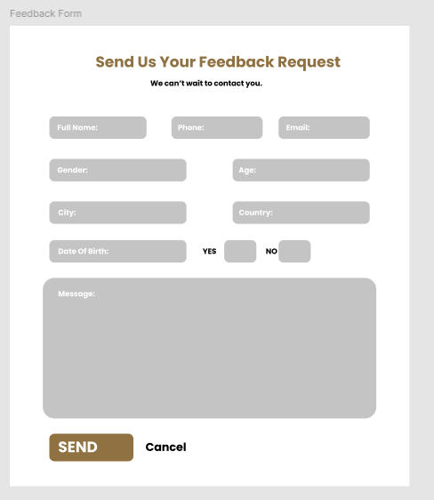
Prototype Overview
Home
About Us
News & Updates
Events
Contact Us
Feedback
Notes:
Prototype: Figma (12/2024) Figma – Website Prototype. Available at: Prototype (13/12/24). Images in Figma included
Logo: Canva(12/2024) Canva - Projects. Available at: Logo (Accessed: 09/12/24).

Slide 8
Development process
Figma for design and prototypes
User testing for feedback
Iterative design process

Slide 9
Feedback and improvements
Feedback
Improved light/dark and text size toggle
Cleaner colour contrasting
Improvements
Add language options
Improve accessibility options navigation
Implement assistive technology (ARIA)
Add more coloured themes
Improve text size quality, auto size fit to page and boxes

Slide 10

Conclusion
Summary
Prototype designed for inclusivity and usability.
Demonstrates core accessibility principles.
Next steps
Develop a fully functioning web application.

